Slide 1

Team Name : Team Charlie
Team Leader Name : Nikhil Kumar
Problem Statement : AI-Powered Personal Learning Assistant

Slide 2

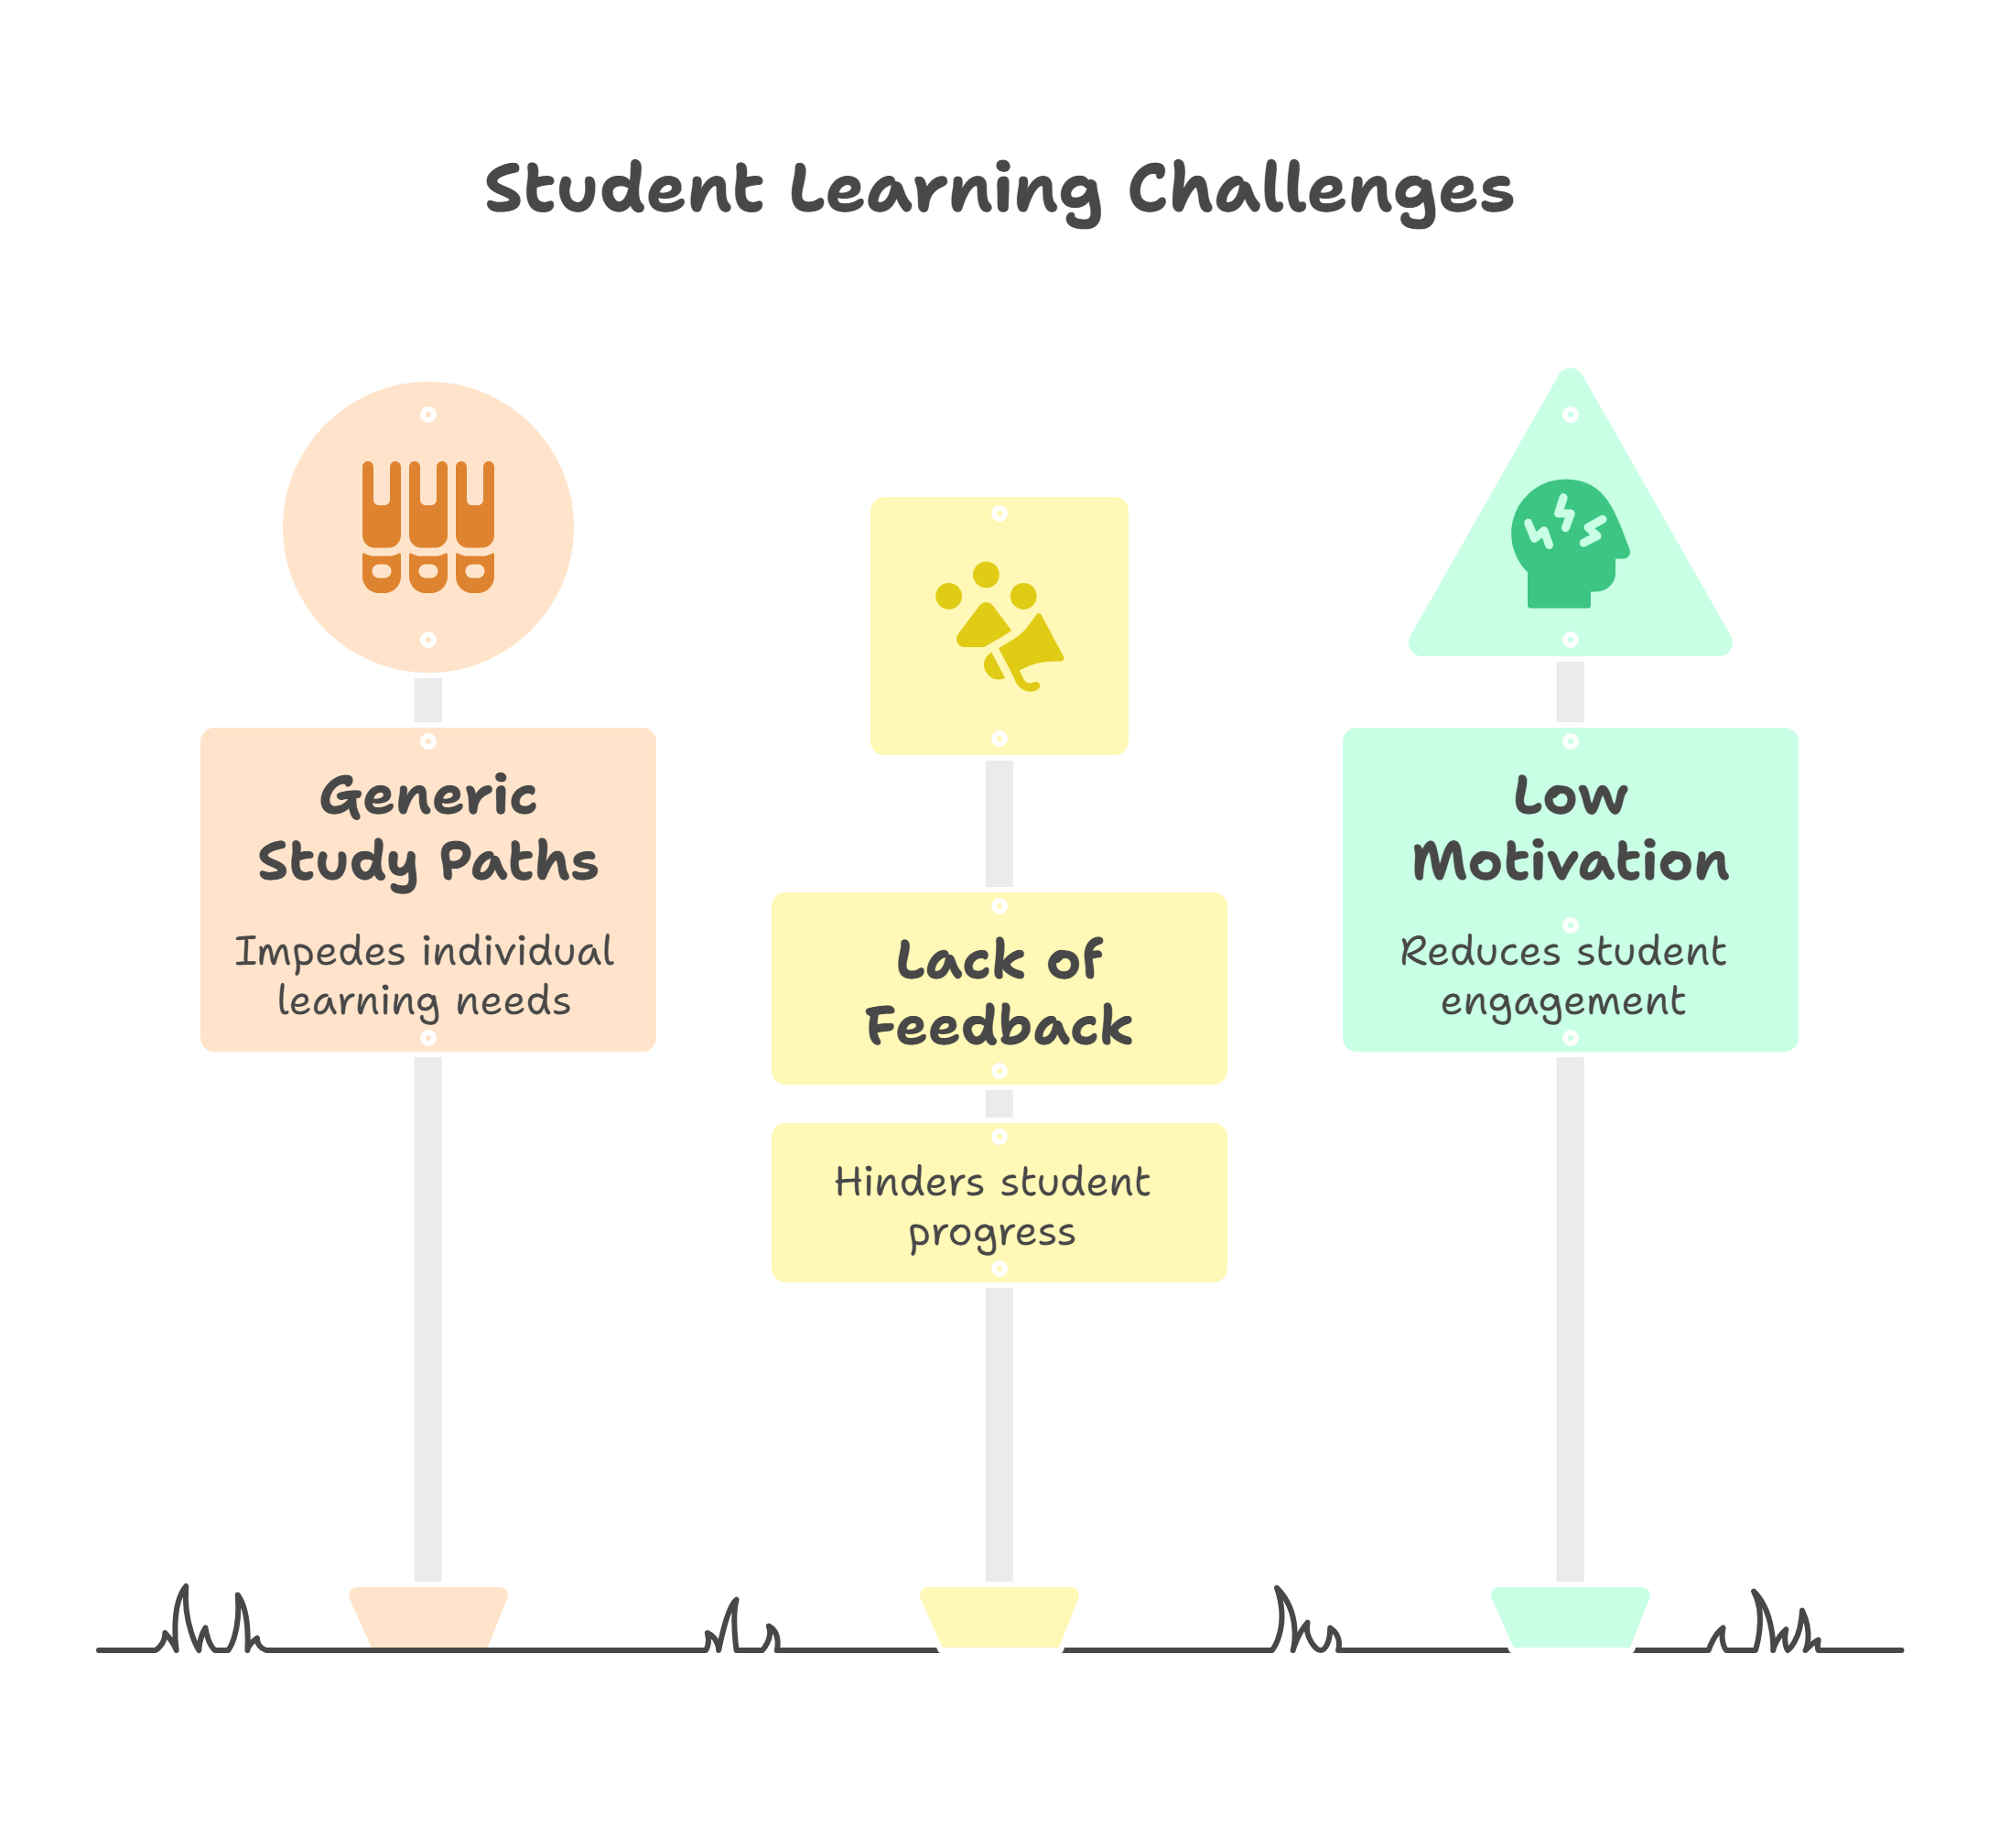
Brief about the prototype:
Students struggle with:
Generic one-size-fits-all study paths
Lack of personalized feedback.
Difficulty staying motivated and engaged.
Visual: Confused student juggling books, time, and stress

Slide 3
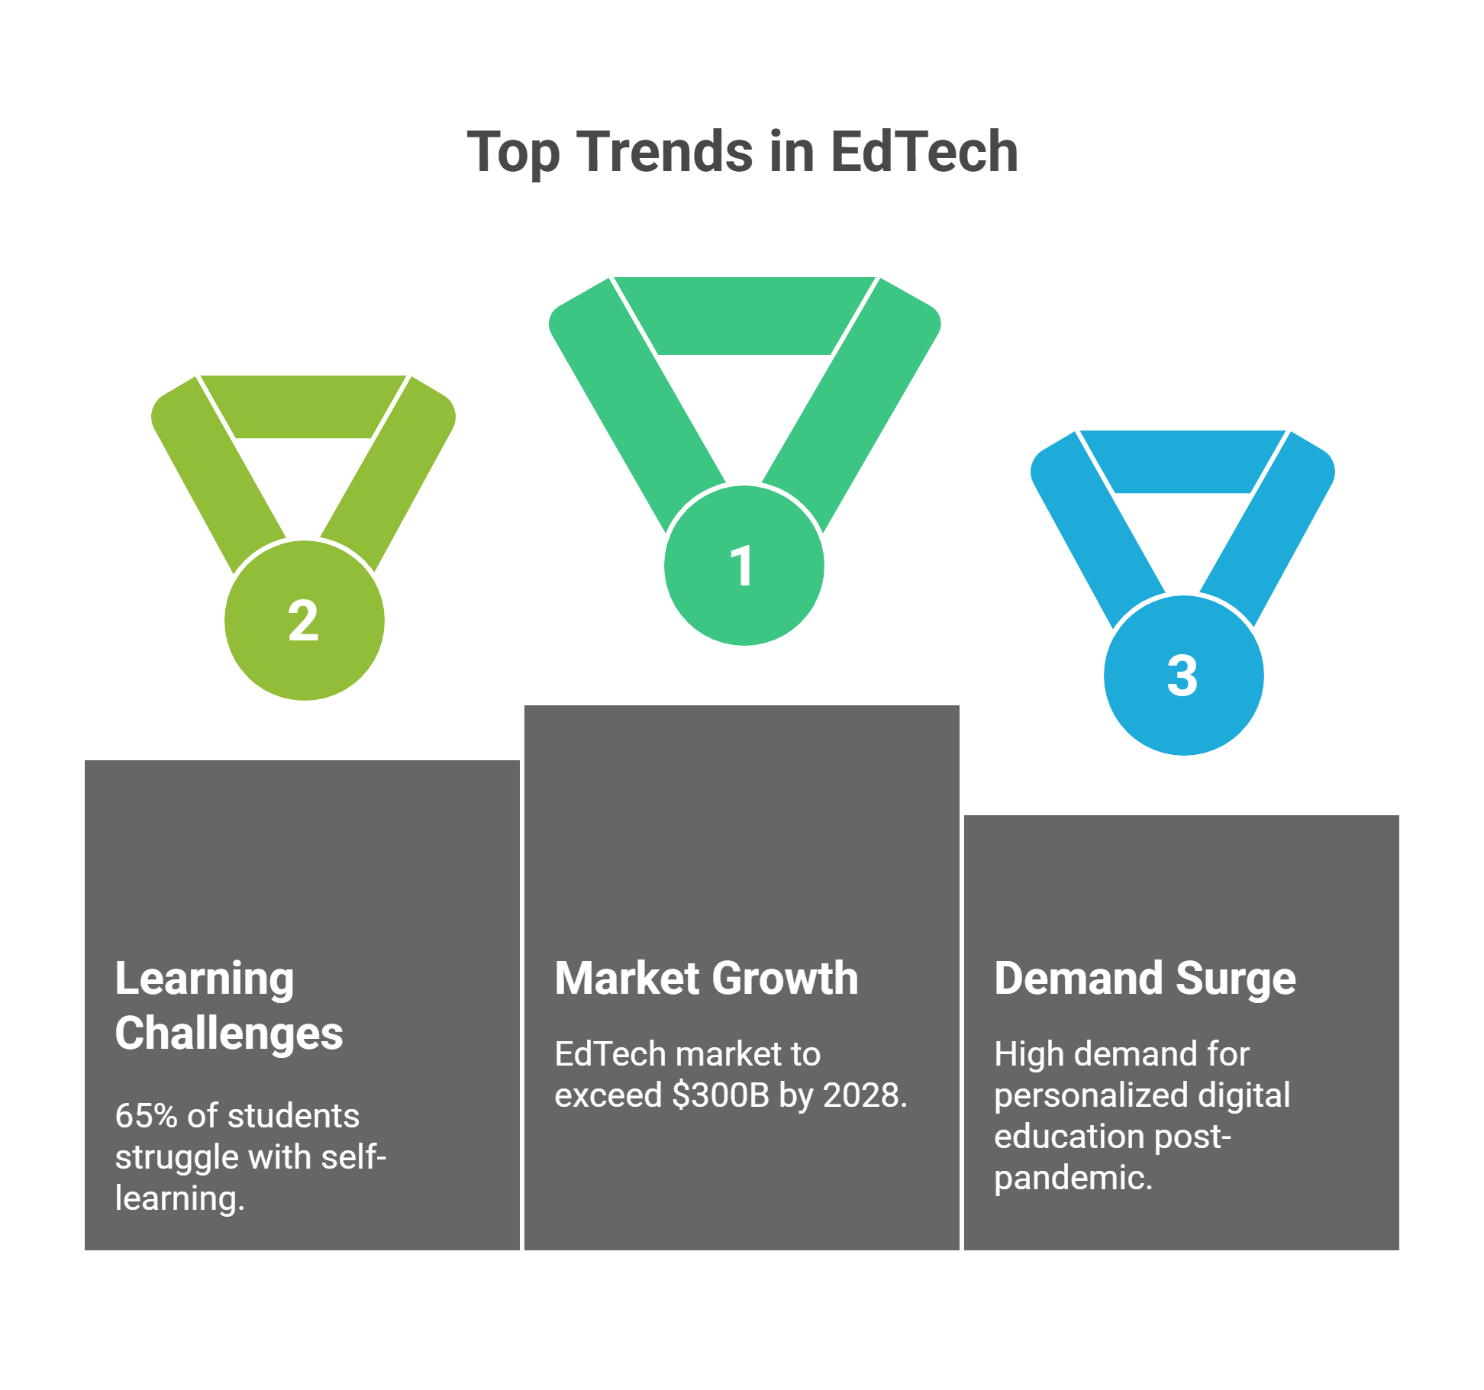
Opportunity should be able to explain the following:
Global EdTech market $300B+ by 2028
65% of students report difficulties with self-learning
Post-pandemic: personalized digital education is in high demand
Visual: Growth chart of e-learning

Slide 4
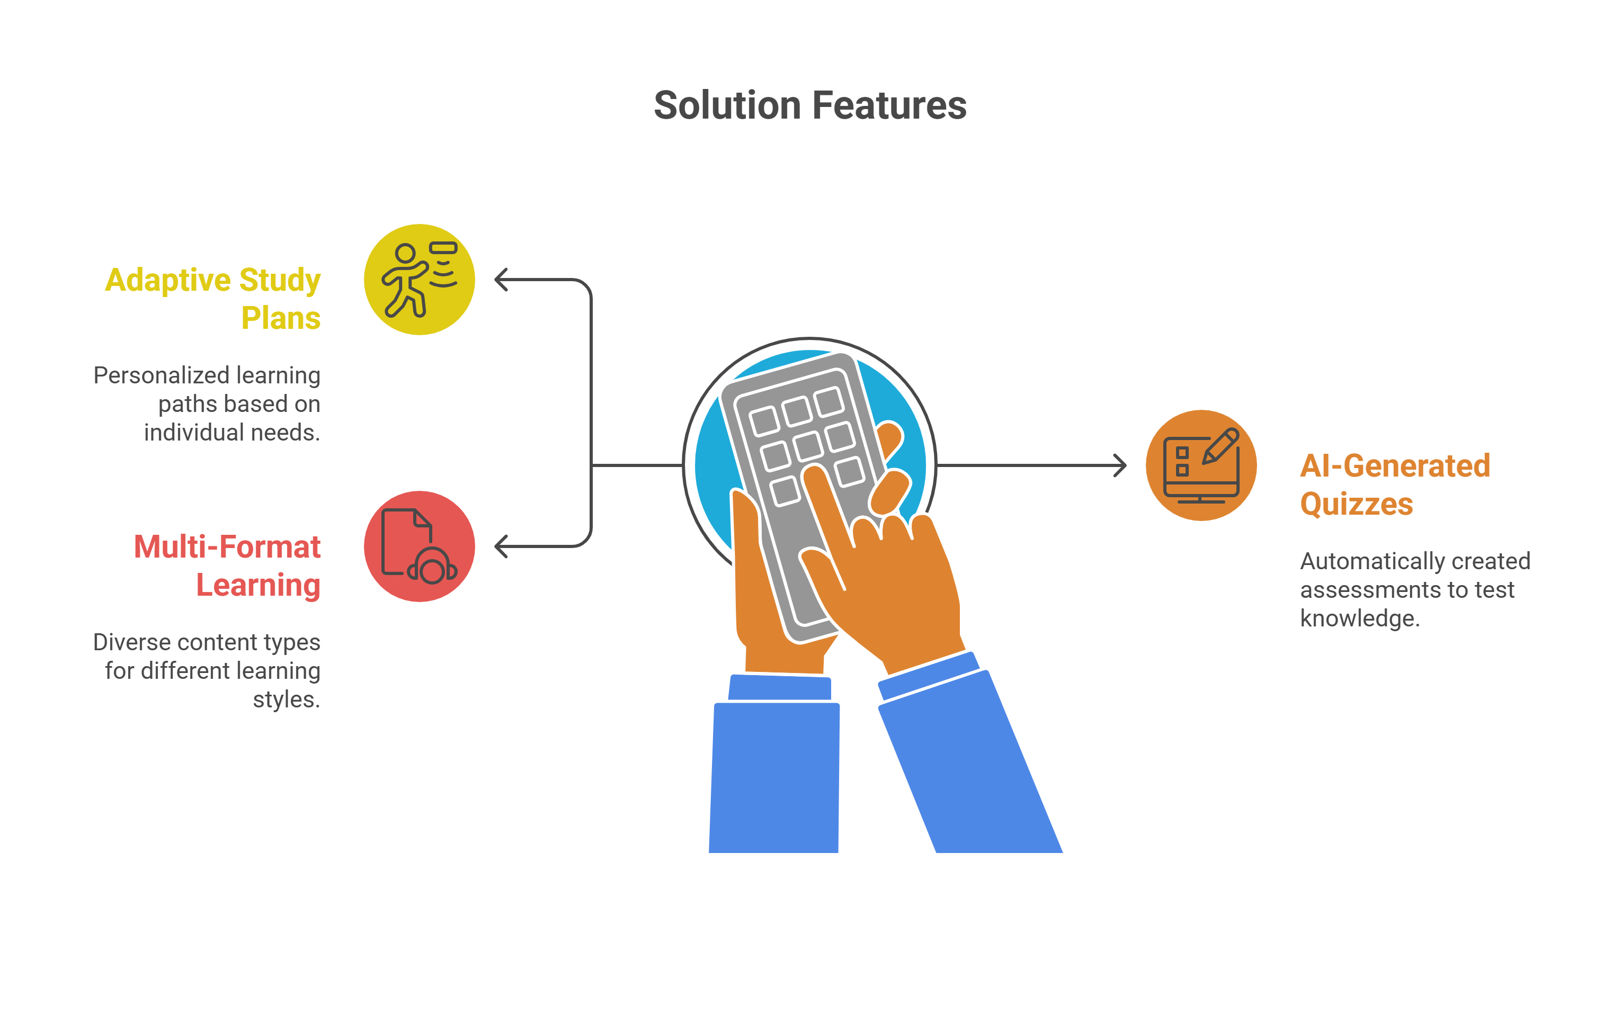
Features:
Our solution: AI-Personal Learning Assistant
Adaptive study plans
AI-generated quizzes/tests
Multi-format learning: text, video, mind maps/visual notes
Visual mockup: chatbot + dashboard

Slide 5
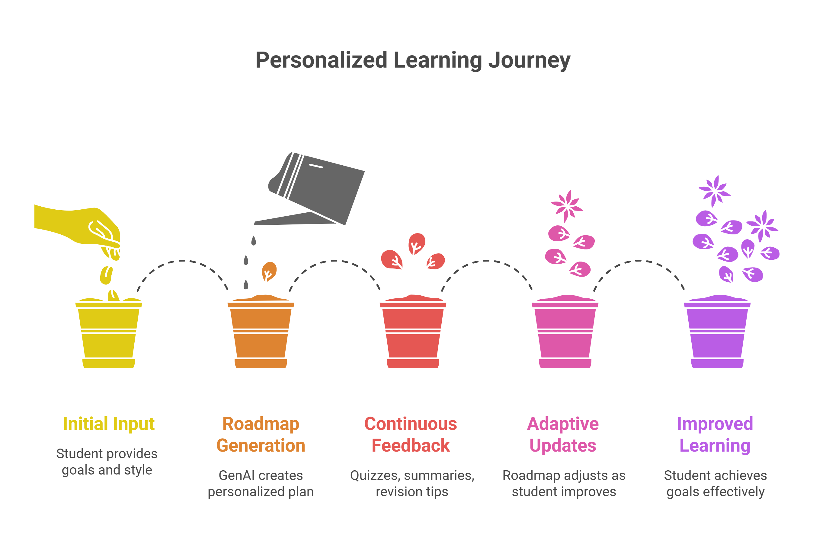
How It Works (Workflow)
Student inputs goals, syllabus, and learning style
GenAI generates personalized roadmap
Continuous feedback: quizzes, summaries, revision tips
Adaptive updates as student improves

Slide 6
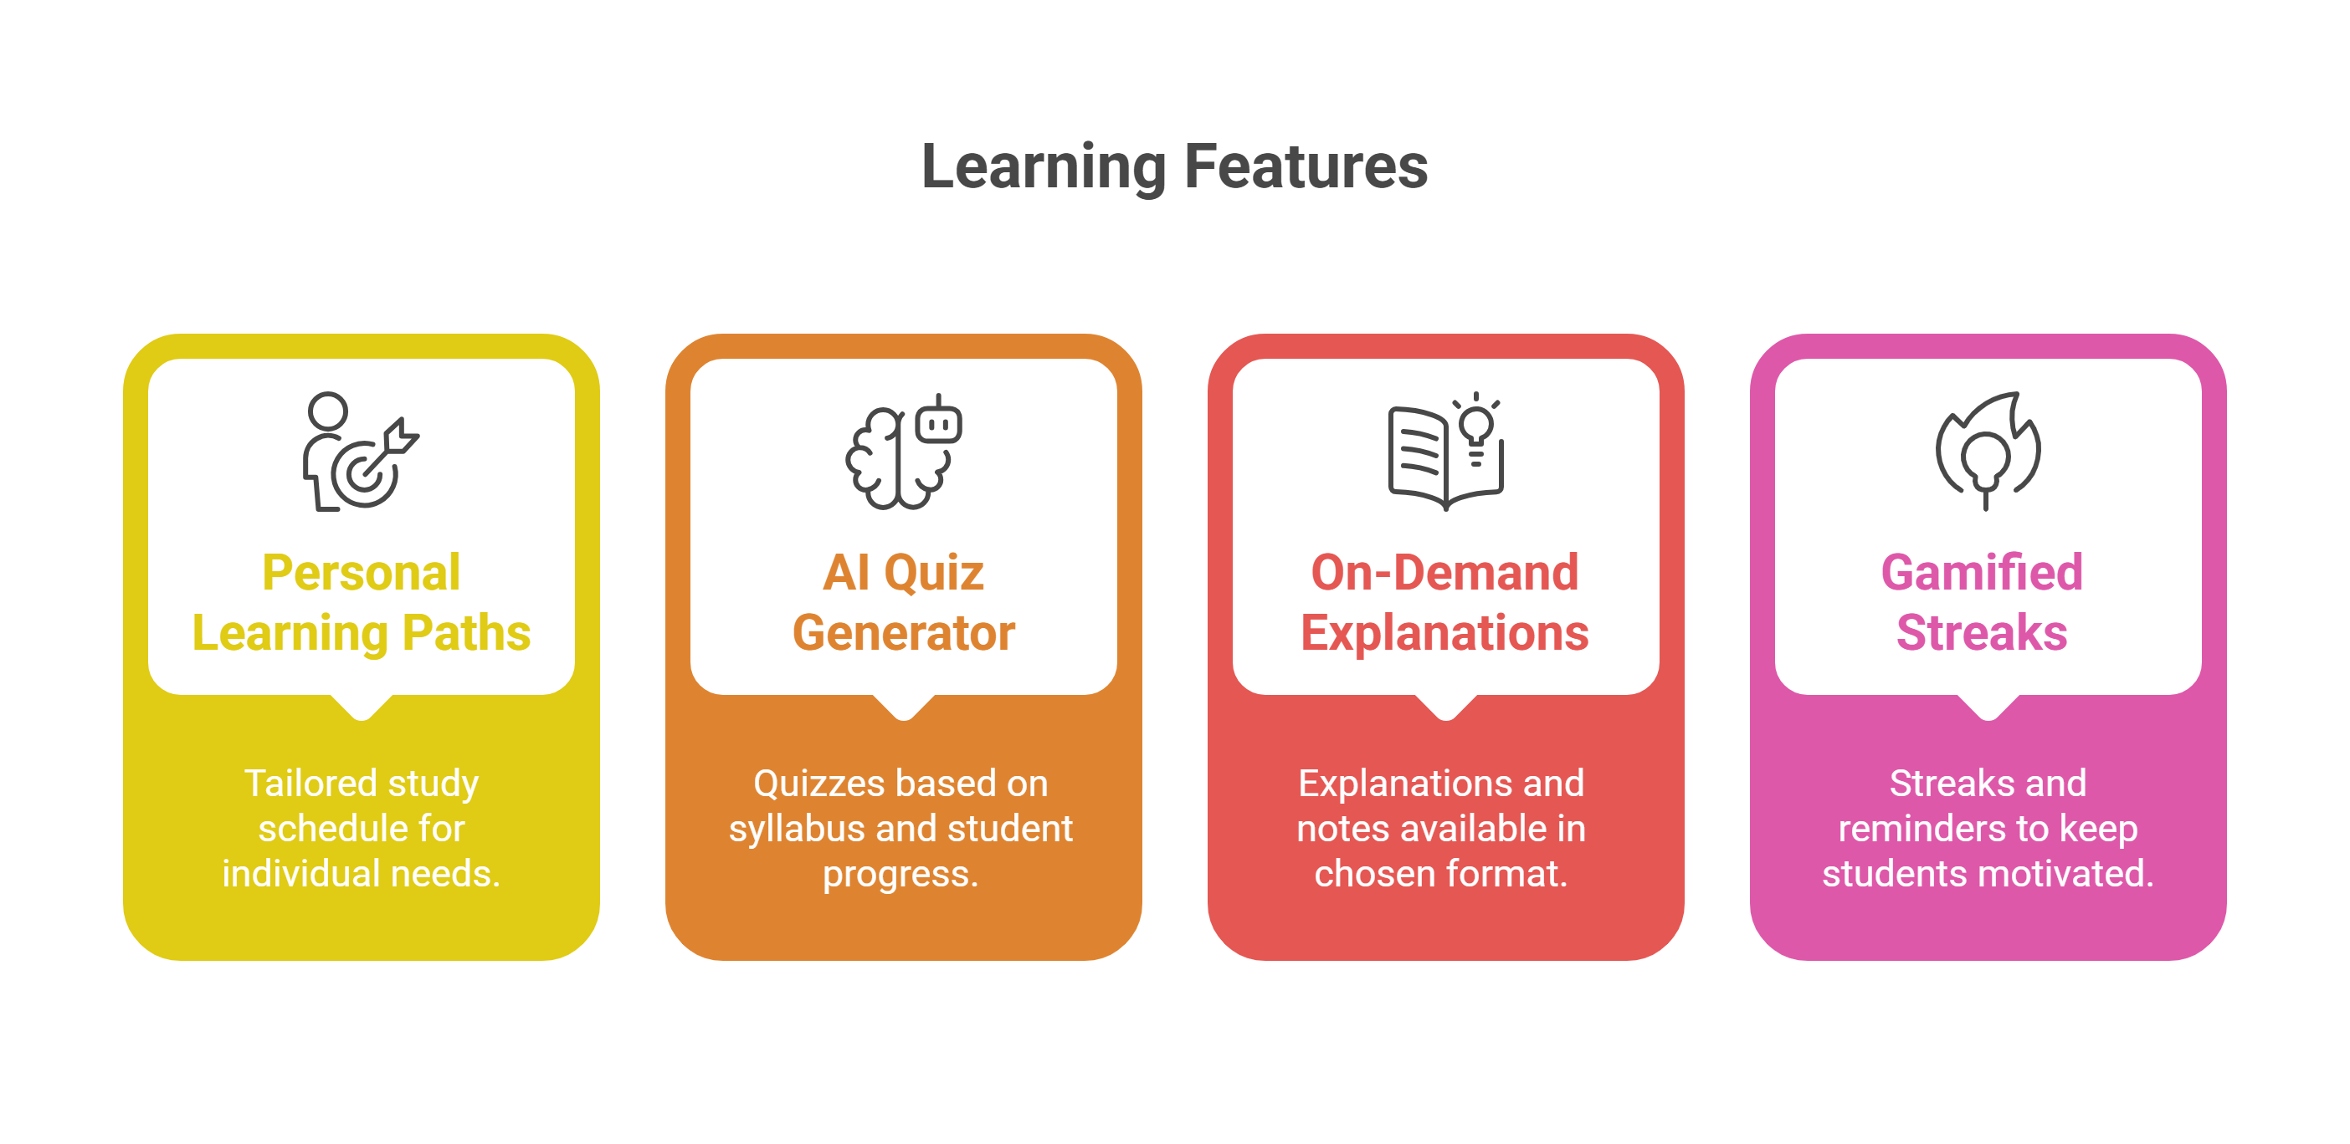
Core Features:
Personal Learning Paths (tailored study schedule)
AI Quiz Generator (based on syllabus + progress)
Explanations/Notes On-Demand (in chosen format)
Gamified streaks & reminders (keep students motivated)
Visual: Icons for quiz, notes, roadmap, motivation

Slide 7
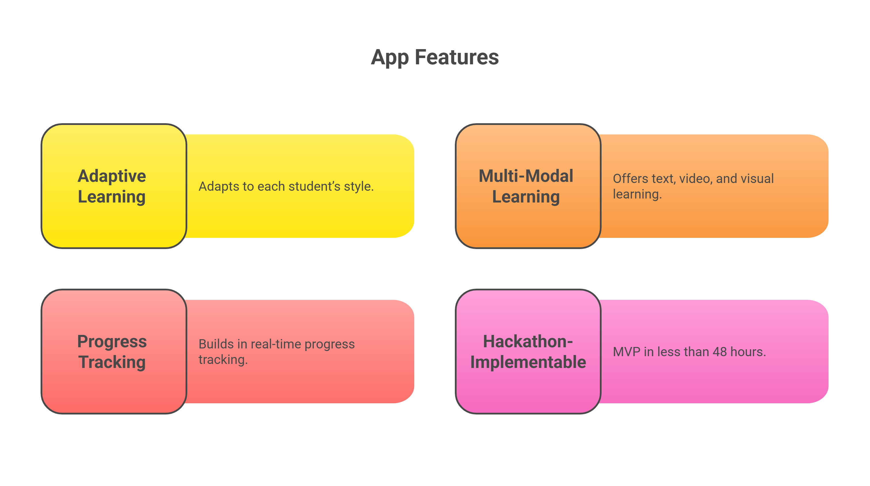
Differentiation:
Unlike generic study apps, we:
Fully adapt to each student’s style
Offer multi-modal learning (text, video, visual)
Build in real-time progress tracking
Are hackathon-implementable (MVP in <48hrs)
Visual: Small comparison table (Our app vs Traditional apps)

Slide 8
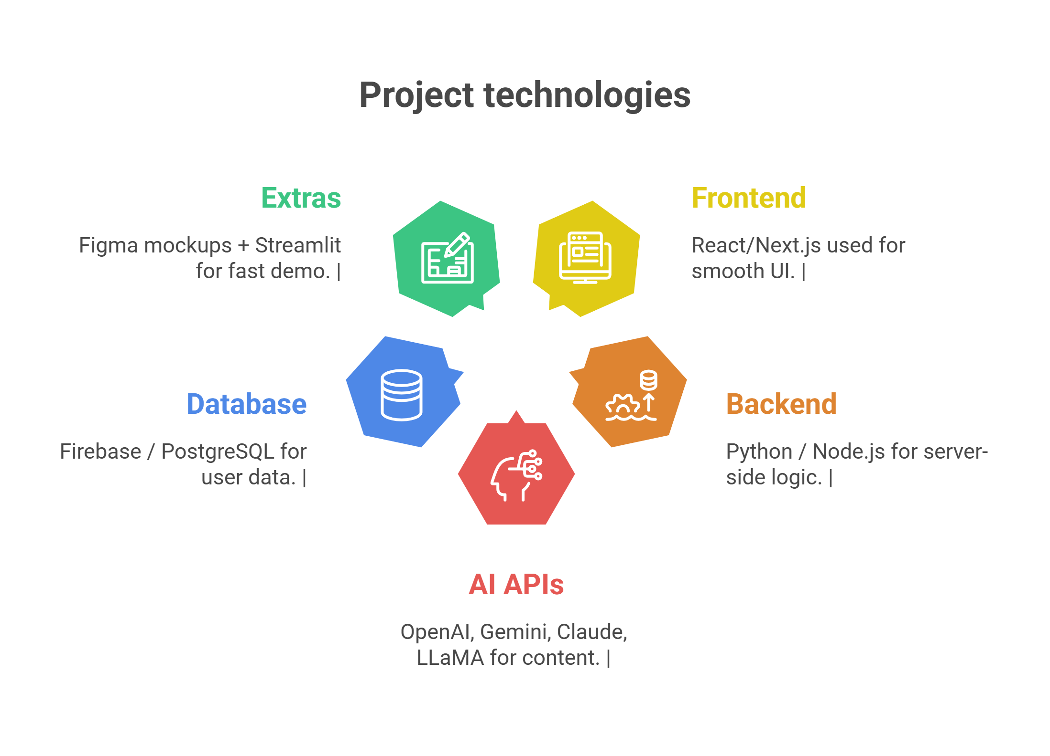
Technologies to be used in the solution:
Frontend: React/Next.js (for smooth UI demo)
Backend: Python / Node.js
AI APIs: OpenAI, Gemini, Claude, LLaMA (for content generation)
DB: Firebase / PostgreSQL (user profile & progress tracking)
Extras: Figma Mockups + Streamlit (fast demo)
Visual: Logos of tech used

Slide 9
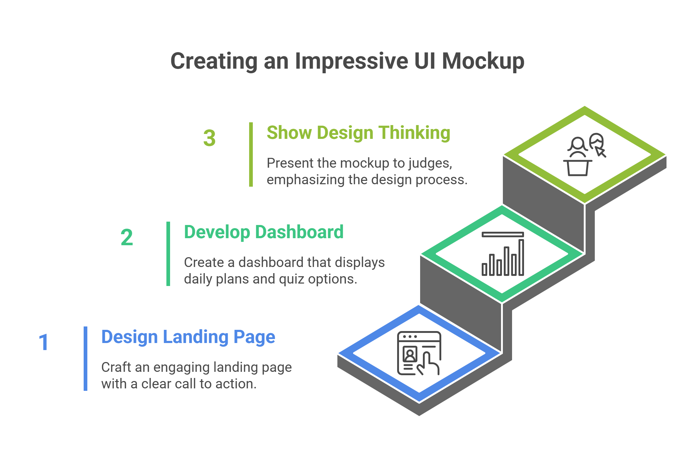
Demo Snapshot / Mockup:
Screenshot/mockup of what UI looks like
Example: Landing page with “Enter your subject”
Dashboard showing “Today’s Plan + Quiz button”
Tips: Even Figma mockup impresses judges—show design thinking

Slide 10
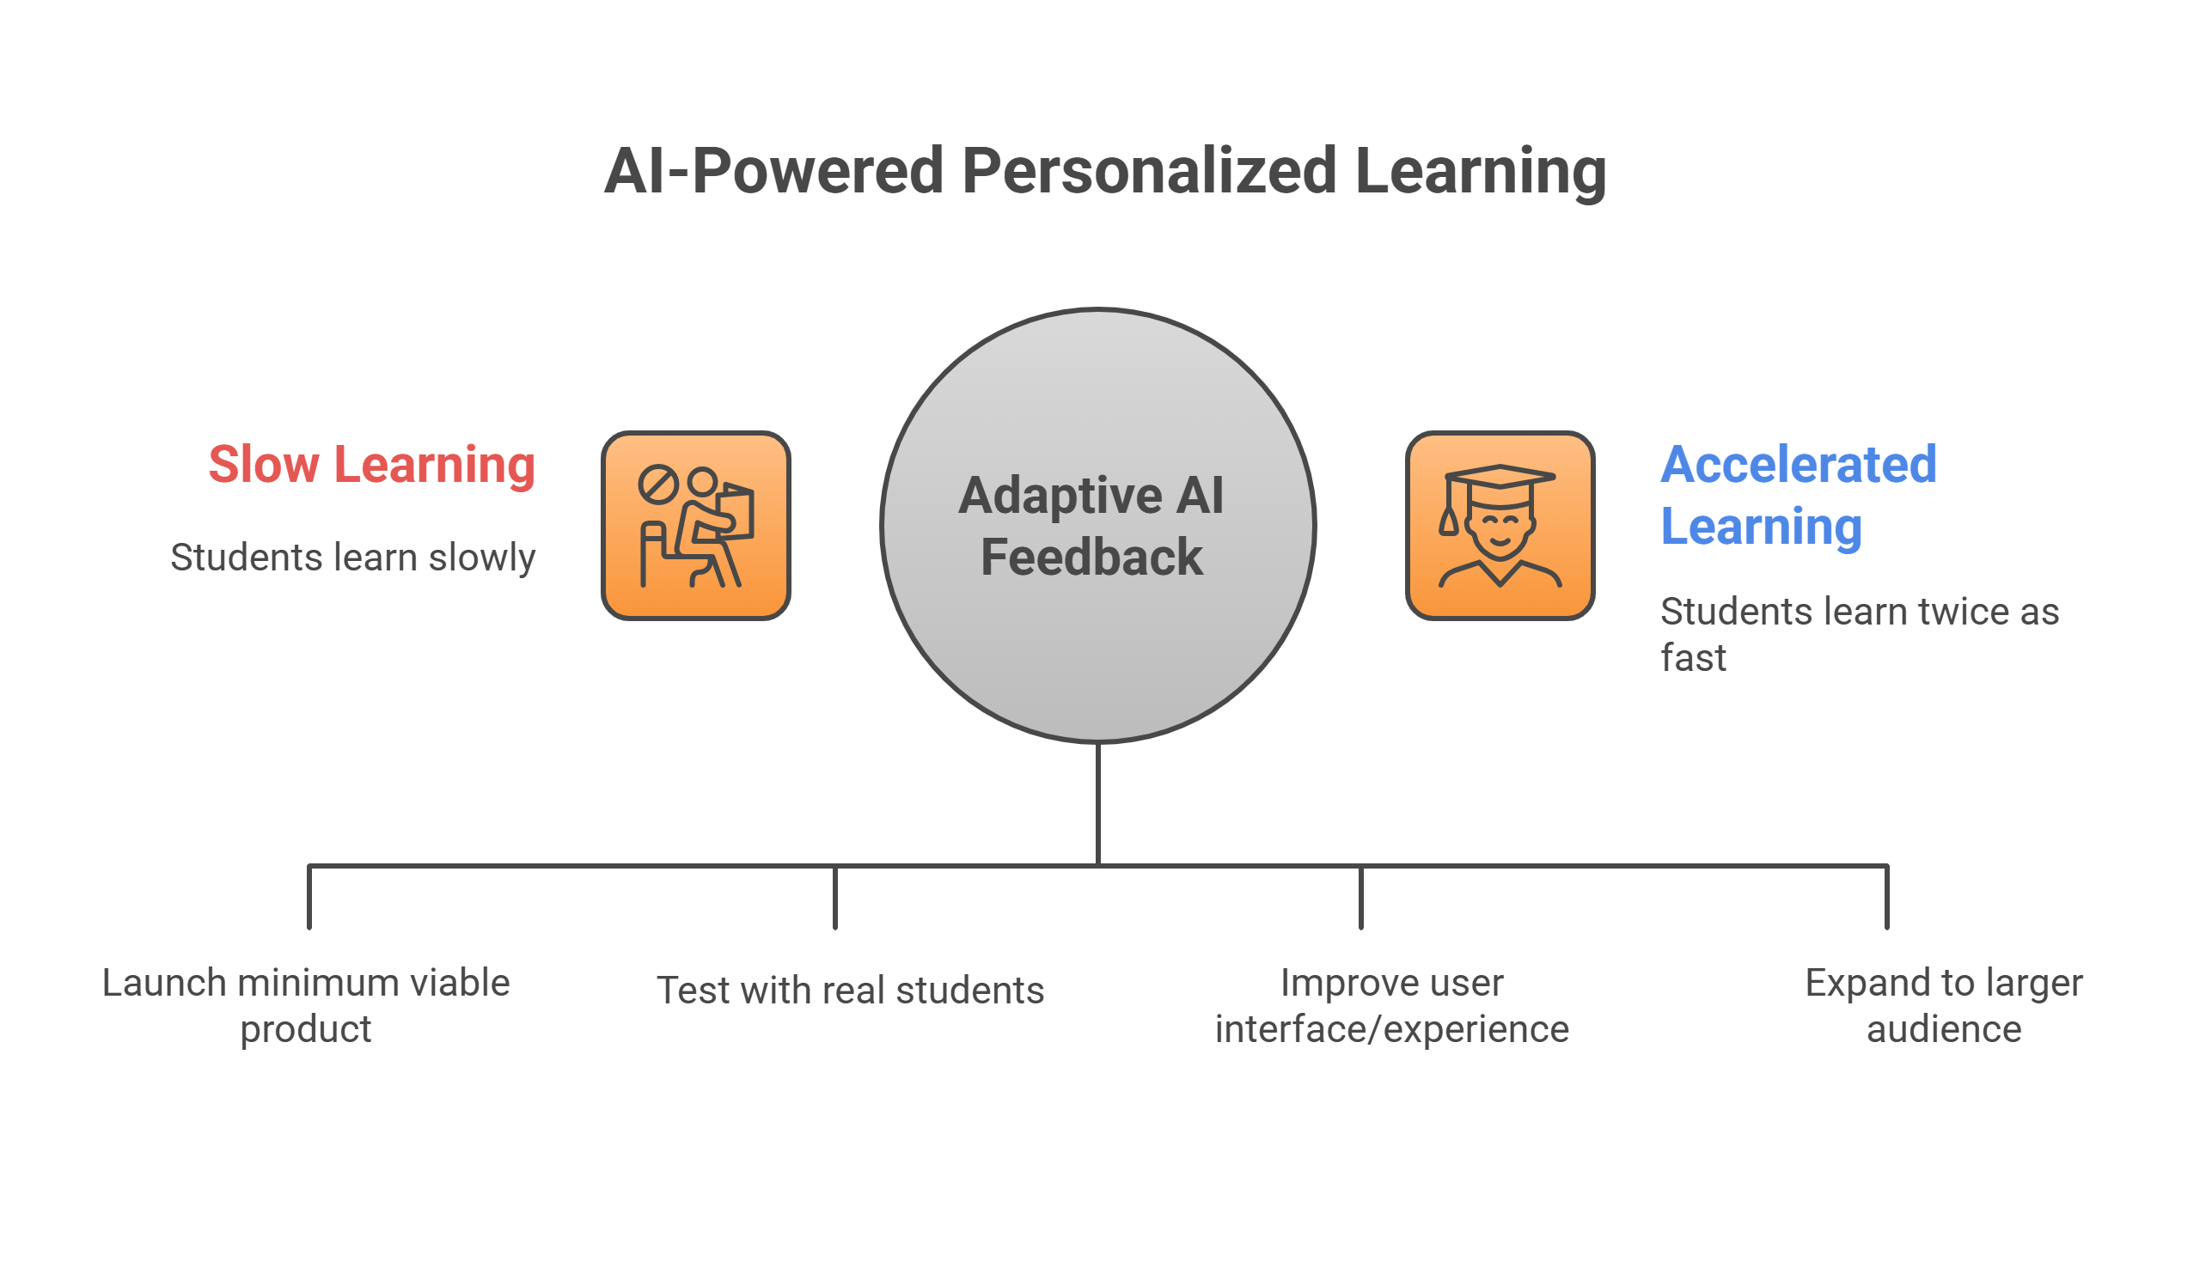
Impact & Next Steps :
Impact:
Students learn 2x faster with adaptive AI feedback
Accessible to different learning styles
Scalable for schools, universities, individuals
Next Steps:
Deploy MVP → Pilot with students → Iterate UI/UX → Scale to platform
Slogan: “Every student deserves their own AI tutor.”

Slide 11


